Slide 1

Comment Anywhere Week 3 Report
Karl Miller, Frank Bedekovich, Luke Bates
2/6/2023

Slide 2
Changes made to the frontend
Basic gui for the frontend created and worked on throughout the week
Program is running on our local servers

Slide 3
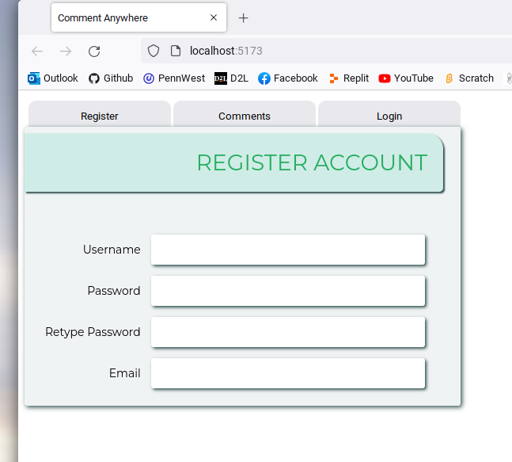
Initial design for the gui

Slide 4
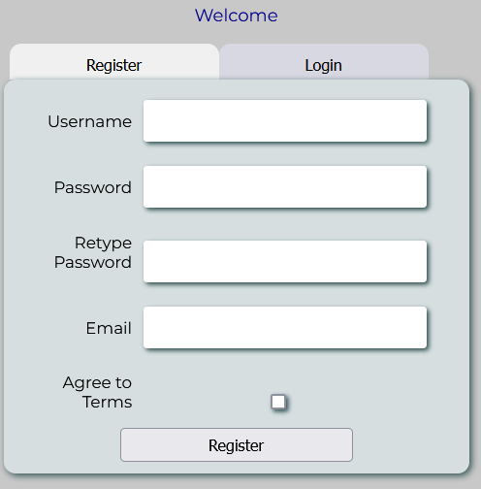
Current GUI Design after several revisions
Program now actually saves the data put into the field to make shure there are no duplicate users

Slide 5
Changes made to the backend
This week Karl made several changes and additions to the backend
User registration and some basic verification was setup
Several functions were added and changed

Slide 6
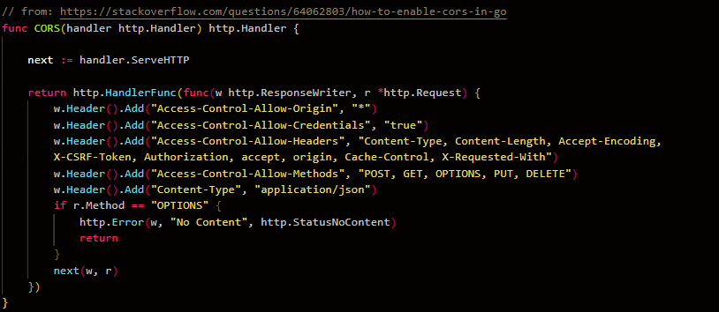
Backend cors functions

Slide 7
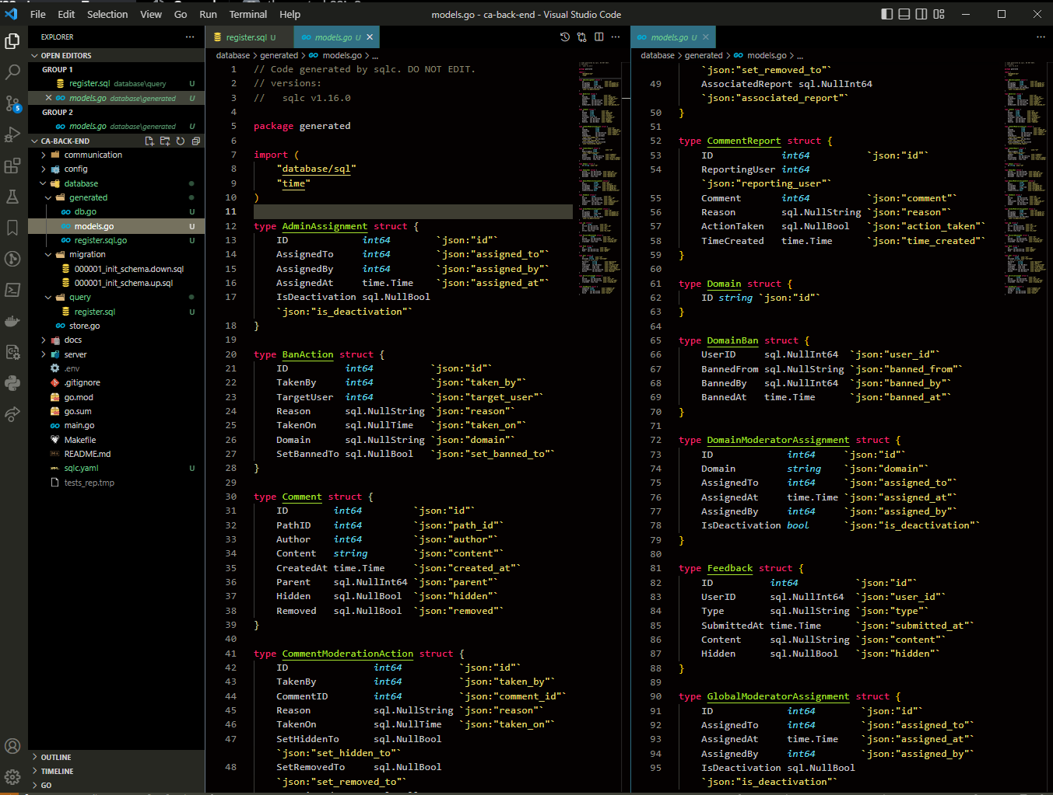
Backend functions

Slide 8
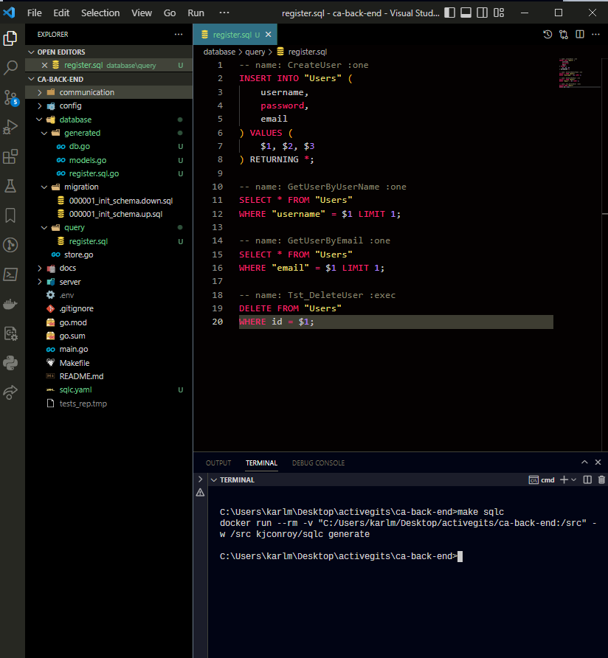
Register section for creating new users

Slide 9
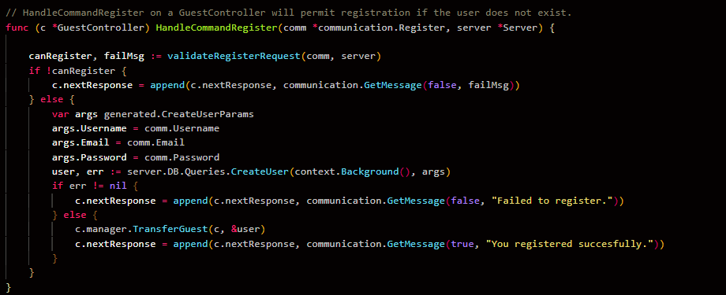
More registration code
This part of the registration checks if the user entered already exists or not.

Slide 10
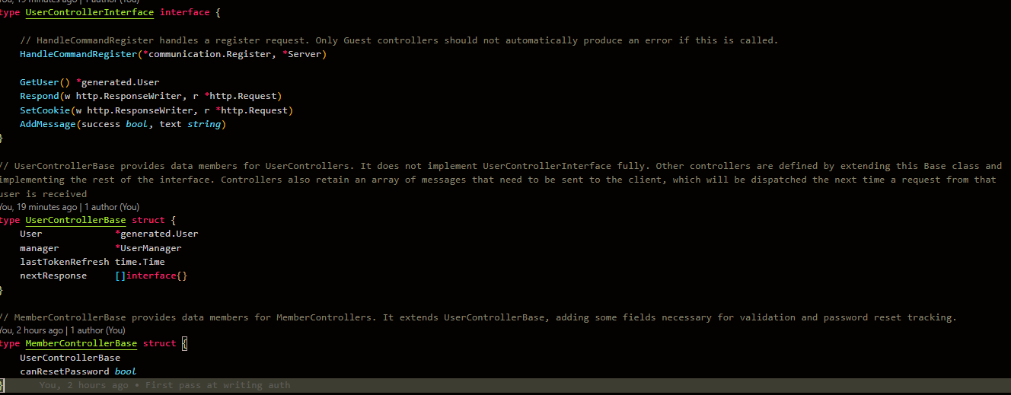
Some newly created controller interfaces

Slide 11
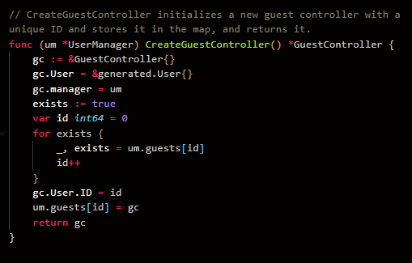
Guest controller interface
The CreateGuestController is used to create a unique id for the newly added user and store it for various other processes.

Slide 12
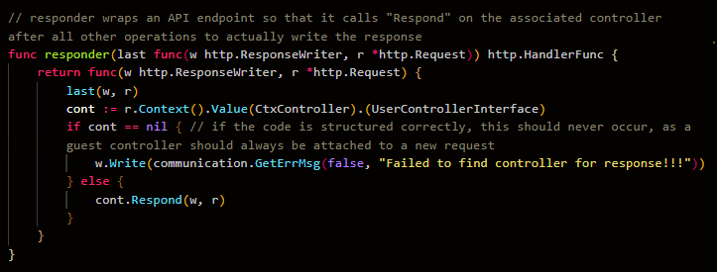
Responder function

Slide 13
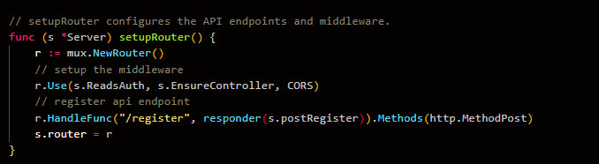
setupRouter function

Slide 14
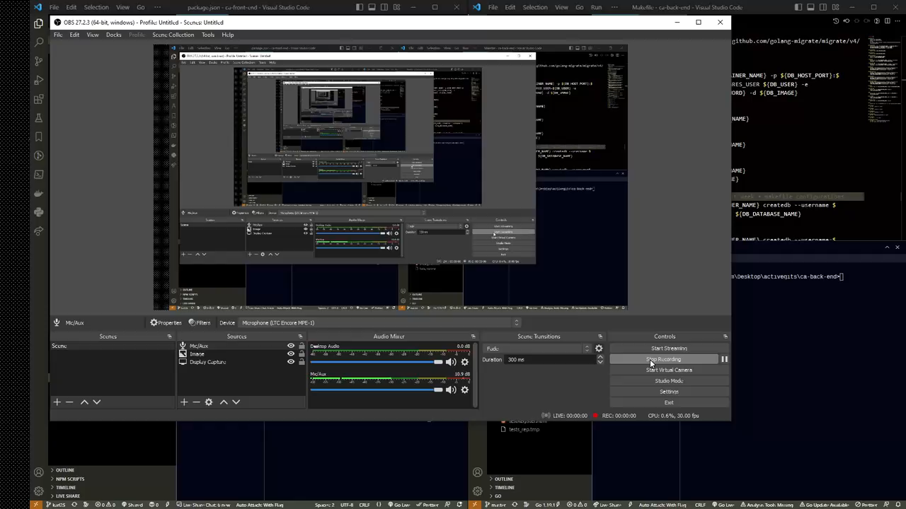
Backend video

Slide 15
Things for next week
Finish implementing a full message chain
Continue stubbing frontend and backend functions
Continue writing and testing methods
Revaluate the gantt chart

